Slide 1
Foundation
SQL – Inline Views and Views

Slide 2

Module Objectives
After completing this module you will be able to:
Explain the concept of using In-Line Views
Join an In-line View with another table
Explain the concept of using Views
Create a view to hide data complexity and re-use it multiple times to filter out different information

Slide 3
In-line views
In-line views appear in a queries FROM section
In-line views are sometimes referred to as ‘temporary tables’
FROM
Notes:
Note: all in-line views can always be created as views and referenced by their names in the FROM clause, rather then through the whole SELECT statement defining the in-line view.
In your exam you should however not do this.
Do not create views and reference them by their names in the FROM clause as you will be penalised.
In your exam always embed the in-line view within the FROM clause of the outer query.

Slide 4
In-line Views – Simple Scenario
Display the highest number of times a single share has been traded.

Slide 5
In-line views – Step 1
First of all construct a query to display the amount of times each share has been traded.
SELECT share_id,
COUNT(share_id) AS times_traded
FROM trades
GROUP BY share_id;

Slide 6
In-line views – Step 2 (Solution)
Now select the highest amount from your initial query.
SELECT MAX(times_traded)
FROM
(
SELECT share_id,
COUNT(share_id) AS times_traded
FROM trades
GROUP BY share_id
);
Notes:
Note that this could have been done much more easily by using MAX(COUNT(share_id)) instead of an inline view.
Note also the importance of aliasing the aggregate column in the inline view – if you don’t do this the outer select statement won’t work.

Slide 7
In-line views – Practice
Use an inline view to display the following information:
The average number of trades made by a single broker.
The highest average share price for a single share.

Slide 8
In-Line Views – Advanced Scenario
In the next scenario we’ll see that in-line views have their own use.
Display broker ids with the number of different shares traded by each broker id
Notes:
Note: brokers can trade one share many times. The above query is not interested in how many times each share has been traded. Instead, it aims to remove duplicated shares and show the number of different shares traded by each broker.

Slide 9
In-line views – Step 1
First of all construct a query to display the list of broker ids with shares traded.
SELECT broker_id,
share_id
FROM trades
;

Slide 10
In-line views – Step 2
Next construct a query to display the list of broker ids with different shares traded by each broker.
SELECT DISTINCT broker_id,
share_id
FROM trades
;
Notes:
Note: the keyword DISTINCT in the above query applies to both broker_id and share_id. It will return all different (broker_id, share_id) pairs.

Slide 11
In-line views – Step 3 (Solution)
Finally construct a query to display the number of different shares traded by each broker: the query from step 2 is used as a table (in-line view).
SELECT broker_id,
COUNT(share_id) AS "No of Different Shares"
FROM (SELECT DISTINCT broker_id,
share_id
FROM trades)
GROUP BY broker_id
ORDER BY broker_id;
Notes:
Note: share_id in the sub-query (in-line view) does not need to be aliased, as it is not preceded by a table alias, no function is applied to it, it is not part of a formula, and is not obtained by concatenating two or more columns.
In this case, the in-line view acts as a table with two columns: broker_id and share_id. The outer query applies the COUNT aggregate function to the view’s second column (share_id).

Slide 12
In-line views – Practice
Use an inline view to display the following information:
Display broker ids with the number of different stock exchanges they traded in by each broker id
Display shares with the number of different stock exchanges where share was traded for each share

Slide 13
In-Line Views – Advanced Scenario
In the next scenario we’ll see that in-line views can be aliased and joined to tables.
Display the total value of shares traded for this quarter for every broker. Display broker’s names and include brokers who have never made any trade.

Slide 14
In-line views – Step 1
First of all construct the query to display the total amount traded by all brokers including those who’ve never made a trade.
SELECT
b.first_name||' '||b.last_name AS broker,
SUM(t.price_total) AS total
FROM
brokers b
LEFT OUTER JOIN
trades t
ON t.broker_id = b.broker_id
GROUP BY
b.first_name||' '||b.last_name
;

Slide 15
In-line views – Step 2
Then include the where clause to restrict trades to the ones made in this quarter.
SELECT
b.first_name||' '||b.last_name AS broker,
SUM(price_total) AS total
FROM
brokers b
LEFT OUTER JOIN
trades t
ON t.broker_id = b.broker_id
WHERE
TO_CHAR(t.transaction_time,'YYQ') = TO_CHAR(SYSDATE,'YYQ')
GROUP BY
b.first_name||' '||b.last_name
;

Slide 16
In-line Views – Step 2
This is not adequate.
Why?
The LEFT OUTER JOIN is retrieving all brokers, the WHERE clause is then removing the ones that haven't made any trade in this quarter.
The issue is in the sequence of events with the WHERE being executed after the OUTER JOIN.
Notice also that the total amount traded for each of the brokers who have made a trade in this quarter is less than with the previous query.
This is because the second query looks at trades made in this quarter only.

Slide 17
In-line views – Step 2
To fix this we need the WHERE clause to run before the join.
Solution: the query with the WHERE clause will be an in-line view replacing the trades table
SELECT b.first_name||' '||b.last_name AS broker,
SUM(q.price_total) AS total
FROM
brokers b
LEFT OUTER JOIN
( SELECT broker_id, price_total
FROM trades
WHERE TO_CHAR(transaction_time,'YYQ') = TO_CHAR(SYSDATE,'YYQ')
) q ON q.broker_id = b.broker_id
GROUP BY
b.first_name||' '||b.last_name
;
Notes:
Notice that this time we need to alias the in-line view in order to reference it in the ON clause and join it to the other table (brokers).
Note: this query too can be done without the use of an in-line view. You could do it using the UNION set function, where the first query is the one from slide 23, and the second one should return all brokers that have not made any trade in this quarter. The second query can be done using a subquery or through an outer join, and in both cases should display the SUM(0) as total, as these brokers have not made any trade.

Slide 18
Thinking Point
Sub-queries and in-line views should be able to run separately

Slide 19
Review – In-line views
What is an In-line View?
Where does it appear?
What must you give your in-line view when joining to another table?

Slide 20
What is a View?
A view is a virtual table that allows you to access data from other tables and views.
A view contains no data itself and therefore does not require additional storage.
The tables upon which a view is based are called base tables.
A view is constructed using SELECT statement that involves one or more columns from one or more tables.
Once created, view acts as a table and can be used accordingly in other SELECT, INSERT, UPDATE and DELETE statements
Notes:
Note: In case of inserts, updates and deletes on a view, the inserted/updated data goes into the view’s base table; deleted data are removed from the view’s base table.
You cannot insert rows into a view, update rows of a view or delete rows from a view, if the view’s defining query contains any of these constructs: JOIN clause, set operator, GROUP BY clause or DISTINCT operator

Slide 21
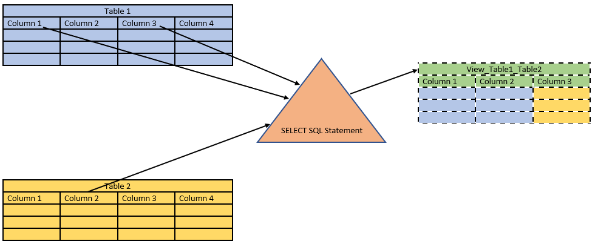
What is a view?
The image above illustrates the process of creating a view from columns 1 and 3 of table 1 and column 2 of table 2
Views are sometimes referred to as ‘virtual tables’

Slide 22
Why views are useful?
To hide data complexity. For example, a view may be used to act as one table when actually several tables are used to construct the result.
To re-use the same view any time you wish to filter out information from it by a different condition.
To use information from another database schema in your current database schema
To present data from another perspective. For example, views provide a means of renaming columns without actually changing the base table’s definition.
To provide an additional level of table security, by restricting access to a predetermined set of rows and/or columns of a base table
Some tasks cannot be done without views

Slide 23
Creating a View
The simplest way of creating a view is:
CREATE VIEW <view_name> AS
<SELECT SQL_statement>;
The recommended way of creating a view is:
CREATE OR REPLACE VIEW <view_name> AS
<SELECT SQL_statement>;
The optional OR REPLACE clause recreates the view if it already exists. With the OR REPLACE option you can recreate an existing view after changing its definition without having to drop the view first.
Notes:
Note: Without the OR REPLACE option, the view cannot be recreated if it already exists. It would have to be dropped and then recreated.

Slide 24
Removing a View
Views can be removed from the database with the following SQL statement:
DROP VIEW <view_name>;
In realty users want to see entities' names, not their ids in the output.
The problem is, queries that provide such information often include many tables and can be rather complex.
It makes sense to save such a query as a view, and then treat it as table in other queries to filter information according to specific needs.

Slide 25
Views – Scenario
Display all trade details, but instead of broker_ids display brokers’ full names, instead of stock_ex_ids display the names of stock exchanges.
In addition, include the currency name used in each trade_id, the name of company that bought the share, and the city and country where the company is based.
Use the above query to filter the rows we need (i.e. by a specific company, or broker, or share, or stock exchange, or city, and so on)
Notes:
Note: the query showing this information requires 7 tables (and 6 joins). Apart from shares_prices and broker_stock_ex, all other tables from the trading platform schema must be used.

Slide 26
Step 1: Create a View to assemble the necessary information
CREATE OR REPLACE VIEW trade_full_details AS SELECT t.trade_id AS "Trade",
b.first_name || ' ' || b.last_name AS "Broker",
t.transaction_time AS "Transaction Time",
t.share_id AS "Share",
t.share_amount AS "Share Amount",
t.price_total AS "Price Total",
se.name AS "Stock Exchange",
cu.name AS "Currency",
c.name AS "Company",
p.city AS "City",
p.country AS "Country"
FROM trades t
INNER JOIN shares s
ON s.share_id = t.share_id
INNER JOIN brokers b
ON b.broker_id = t.broker_id
INNER JOIN stock_exchanges se
ON se.stock_ex_id = t.stock_ex_id
INNER JOIN currencies cu
ON cu.currency_id = s.currency_id
INNER JOIN companies c
ON c.company_id = s.company_id
INNER JOIN places p
ON p.place_id = c.place_id
;
Notes:
Note: in order to be referenced in other queries, columns in the view definition must have an alias in the following cases:
When columns(s) are preceded by a table alias or a table name,
When a function is applied to a column
When column(s) are part of a formula
When columns are concatenated together

Slide 27
Step 2: Use the View to filter out what you need
SELECT "Trade",
"Broker",
"Transaction Time",
"Share",
"Share Amount",
"Price Total",
"Stock Exchange",
"Currency",
"Company",
"City",
"Country"
FROM trade_full_details
WHERE "Company" = 'IBM'
ORDER BY "Trade"
;
SELECT "Trade",
"Broker",
"Transaction Time",
"Share",
"Share Amount",
"Price Total",
"Stock Exchange",
"Currency",
"Company",
"City",
"Country"
FROM trade_full_details
WHERE "Broker" = 'John Smith'
ORDER BY "Trade"
;
Notes:
Note: column aliases from the view’s definition must be used in other queries involving the view
As an exercise, use the trade_full_details view to display trade details for a specific
share,
stock exchange
city
country

Slide 28
Review - Views
What is a View?
In what SQL statements can it be used?
What generally must be done in the view definition so that you can use its columns in other queries?

Slide 29
Questions

Slide 30
Module Objectives
You should now be able to:
Explain the concept of using In-Line Views
Join an In-line View with another table
Explain the concept of using Views
Create a view to hide data complexity and re-use it multiple times to filter out different information

